Slide 1
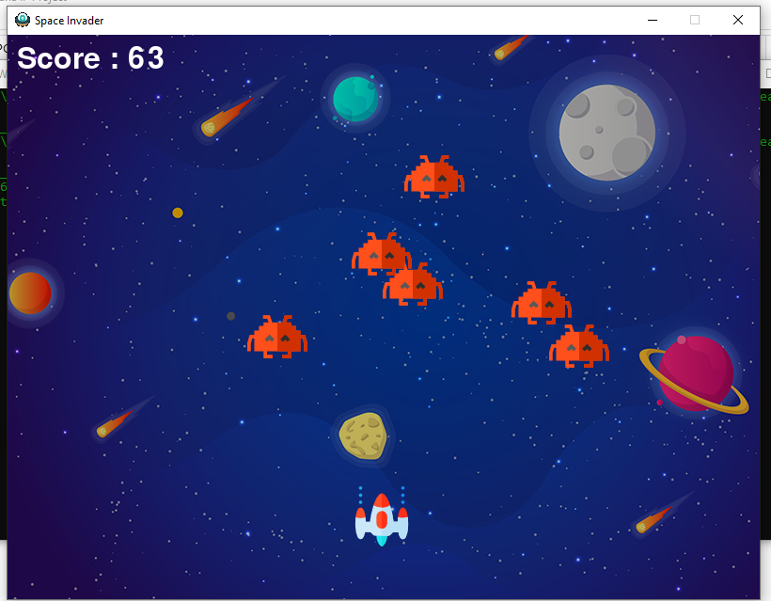
INFORMATICS PRACTICES PROJECT - PRESENTATION
SIDDHANT NAGARIA – XII-SCIENCE
PRIYANSHU AGARWAL – XII-COMMERCE

Slide 2
Introduction
What is Space Invaders ?
Space Invaders is considered one of the most influential video games of all time. It helped expand the video game industry from a novelty to a global industry, and ushered in the golden age of arcade video games. It was the inspiration for numerous video games and game designers across different genres, and has been ported and re-released in various forms.
The objective of Space Invaders, which was one of the earliest video games released, is to pan across a screen and shoot descending swarms of aliens, preventing them from reaching the bottom of the screen. It is viewed as a pioneer of modern gaming.

Slide 3
Why we made space invaders?
The original Space Invaders is designed as an endless loop which means there is no maximum number of levels, just non-stop waves of aliens. It is designed to be impossible to finish it, no matter how many waves you destroy, at one point you will die.
Today, it still had a great involvement of players and especially teenagers.
Space Invaders was one of the first games to become a popular phenomenon, and it’s no understatement to say that it rewrote the rules of gaming.
Space invaders – 1978
Galaxian – 1979
Pacman - 1980
Mario – 1981

Slide 4
Special module – Pygame
Pygame is a cross-platform set of Python modules designed for writing video games. It includes computer graphics and sound libraries designed to be used with the Python programming language.
Applications using pygame can run on Android phones and tablets with the use of pygame Subset for Android (pgs4a). Sound, vibration, keyboard, and accelerometer are supported on Android

Slide 5
Functions / modules used in Our project
Functions used are -
1. Import
2. Range
3. Def
4. While
5. If
6. Elif
Modules used are –
1. Pygame
2. Math
3. Random

Slide 6
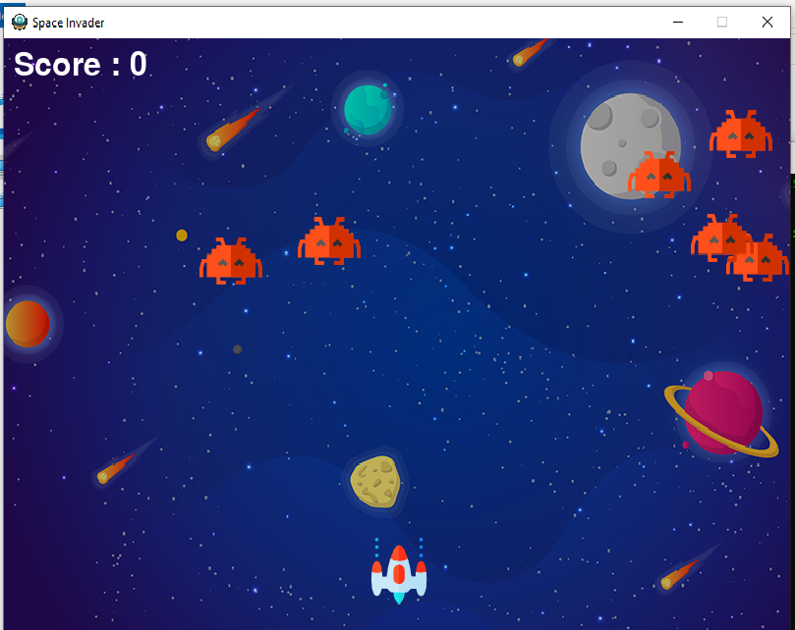
Output screens

Slide 7
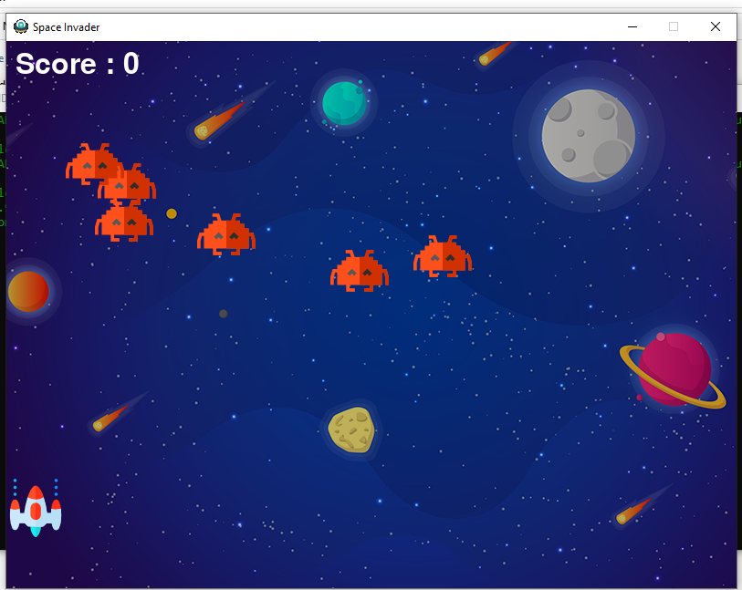
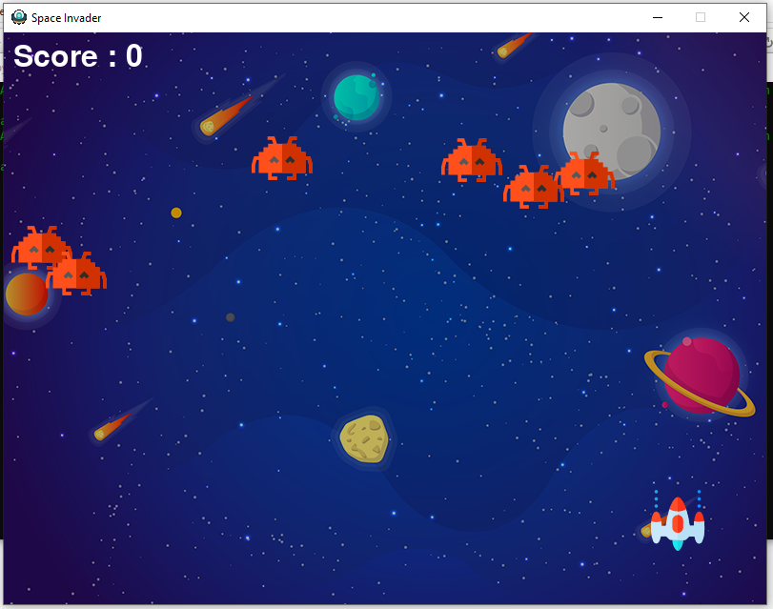

Slide 8
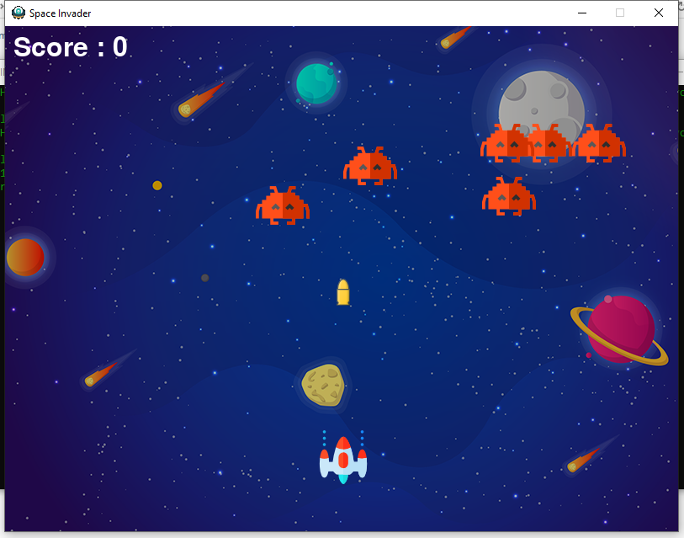
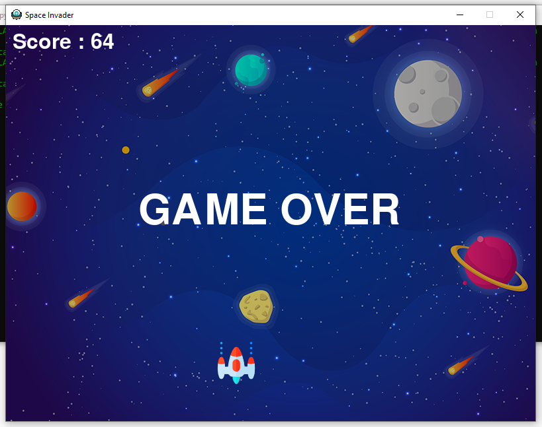

Slide 9
Future scope
Space Invaders is a well – known fascinating game. After its first launch, in Japan. It got a huge success from 1980s, by releasing its new features, updates, improvements, in graphics, sound, etc.
Earlier, people considered it a very easy game. But, later on, after its many updated versions, it started consisting of difficulties, hard levels and much more.
Today, it still had a great involvement of players and especially teenagers.
It has more scope in future as it is upgrading time by time.
Future scope

Slide 10
References
Books used –
1. Informatics Practices – Class XI – Sumita Arora
2. Informatics Practices – Class XII – Sumita Arora
Websites –
1. www.google.com
2. www.wikipedia.org
3. https://realpython.com/pygame-a-primer/

